Slide 1
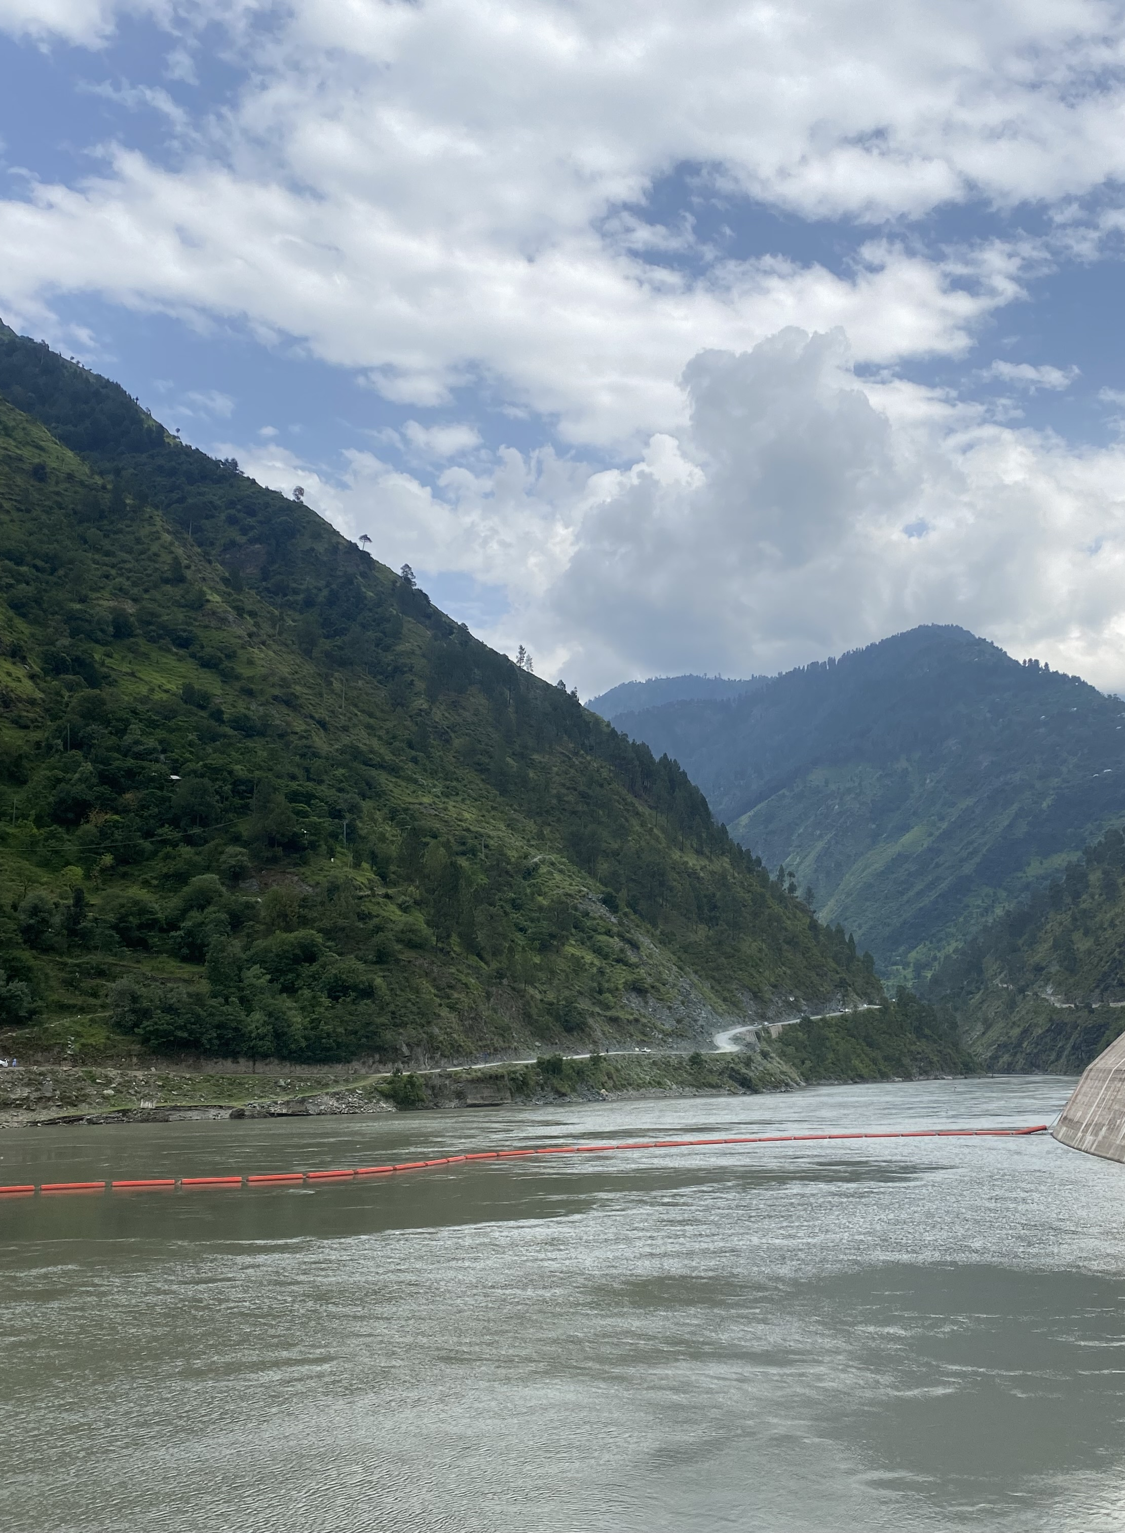
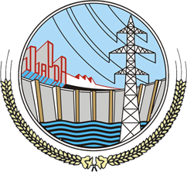
Presentation 9: Dam–Powerhouse Basics
Dr Tahir Mahmood Hayat
Mr Muhammad Tariq 27 April 2024

Slide 2
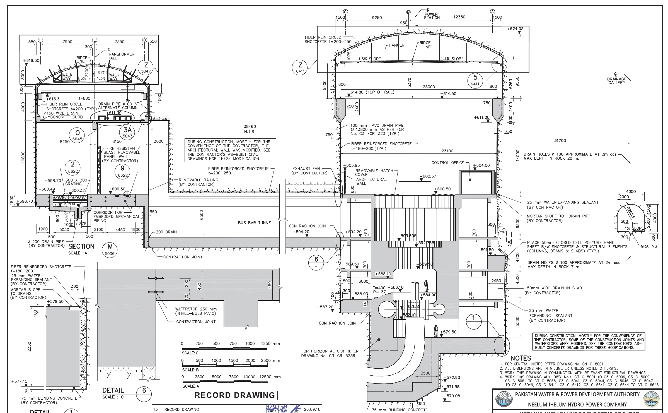
Legend
 | Water flow
 | Scroll case
 | Turbine runner
 | Draft tube
 | Turbine shaft
 | Generator unit
 | Control office
 | Generator hall
 | Transformer hall

Slide 3
Tunnels and construction

Slide 4
Tunnelling
One of the most challenging parts of HEP construction in the Himalaya is tunnelling to allow water to be conveyed from the reservoir to the turbines. Specialised machinery is often required.
Many HEPs utilize a pressurized headrace tunnel to create head over many kilometres, increasing flowrate and thus generating capacity. This needs to be excavated between the headworks and the powerhouse.
Other significant tunneling works must also be completed – including the surge tunnel, and the unpressurised tailrace tunnel, allowing water to return to the river from the powerhouse.

Slide 5
Powerhouse and tunnels

Slide 6
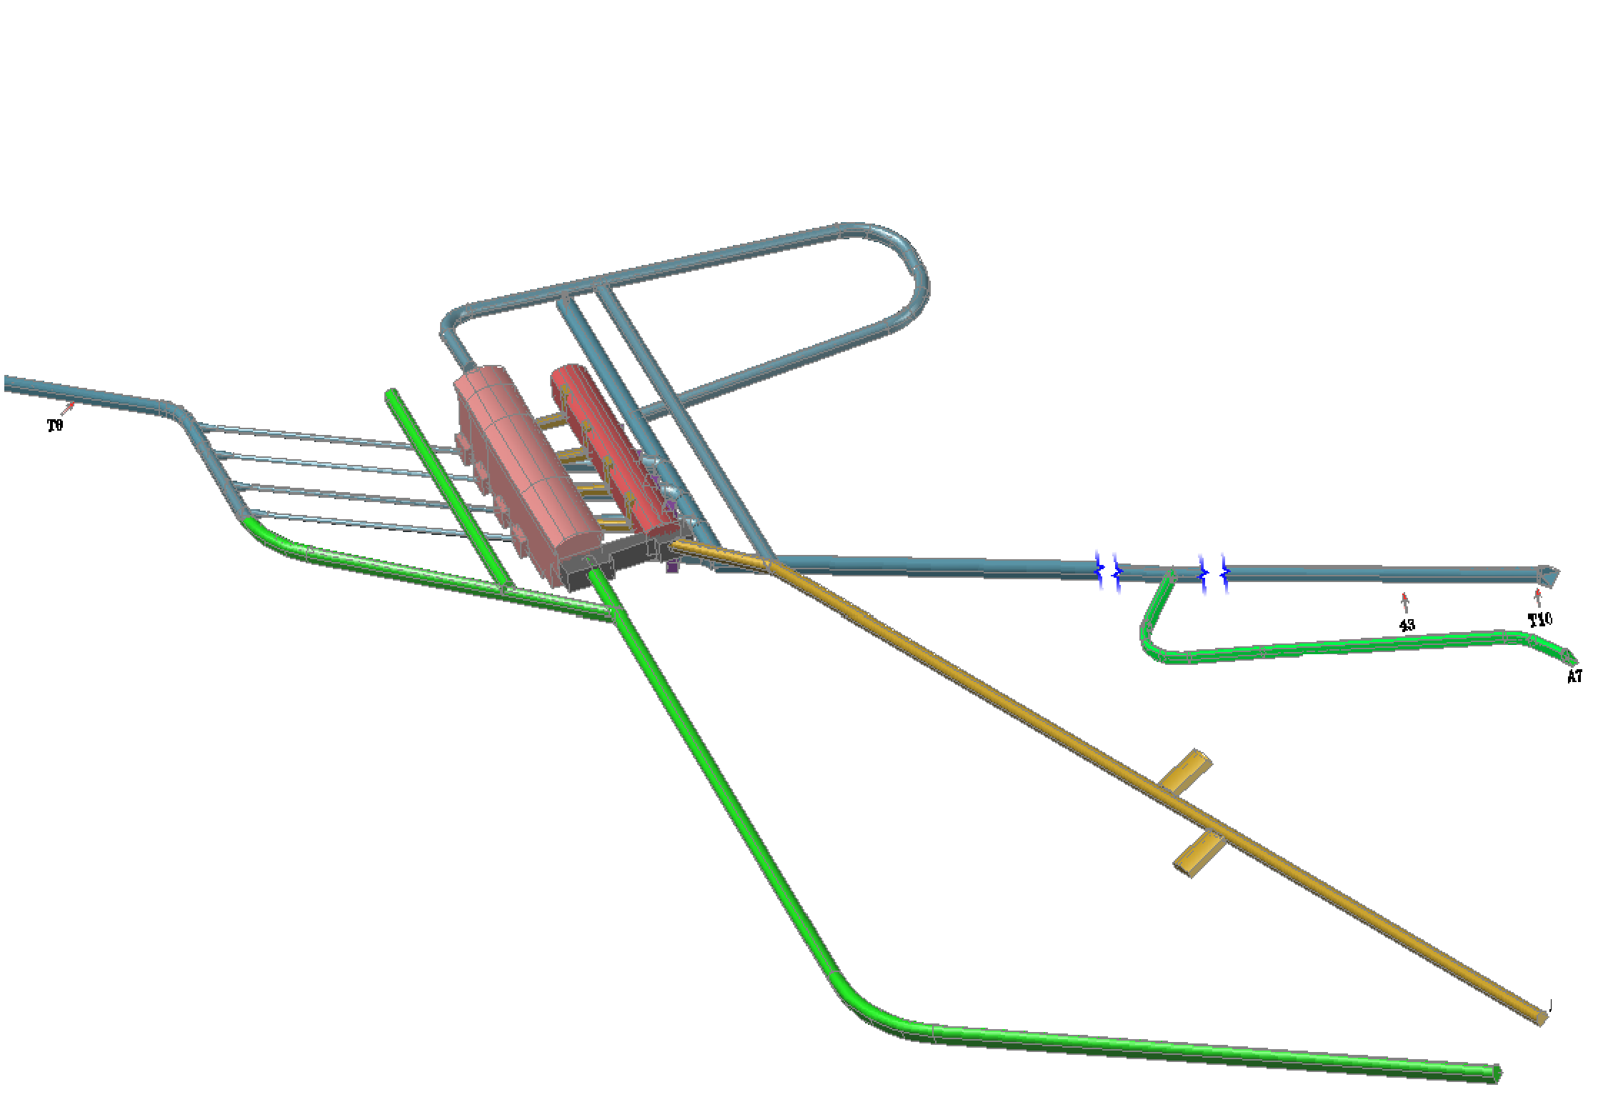
Headrace
Headrace and tailrace
Tailrace Tunnel
Adit A6 Cable
Adit A5 Entrance

Slide 7
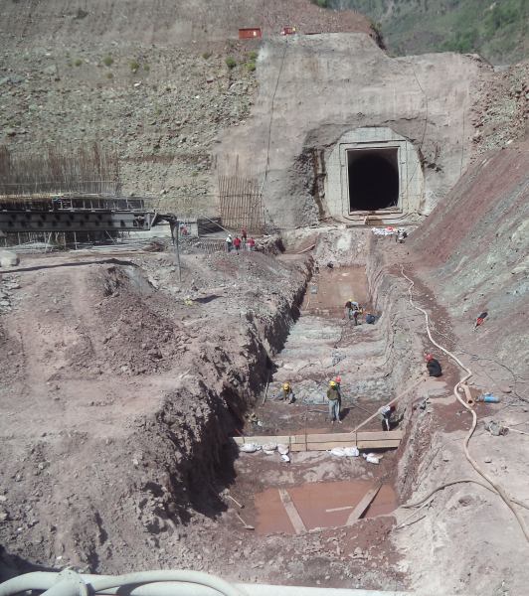
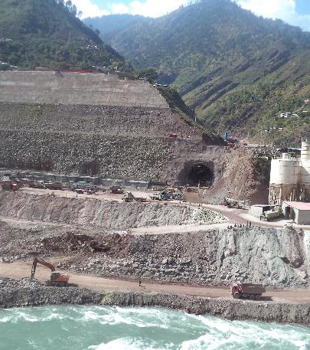
Tunnel excavation
7

Slide 8
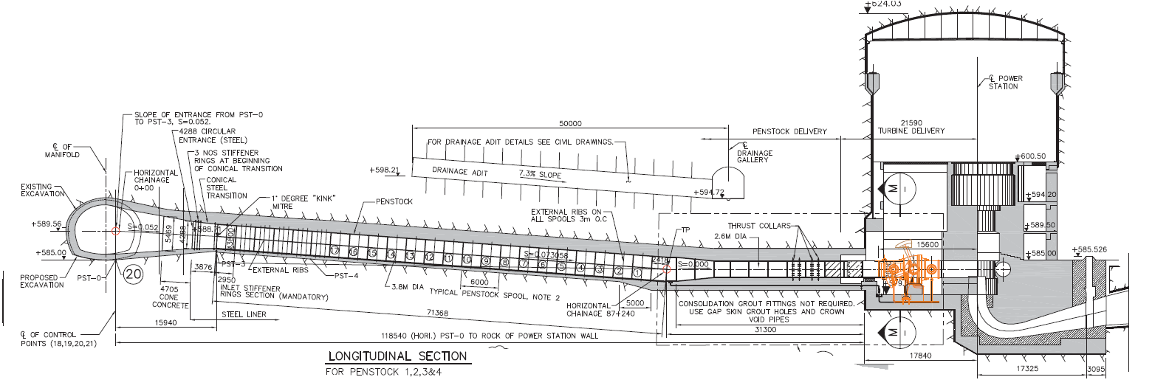
Penstock and inlet

Slide 9
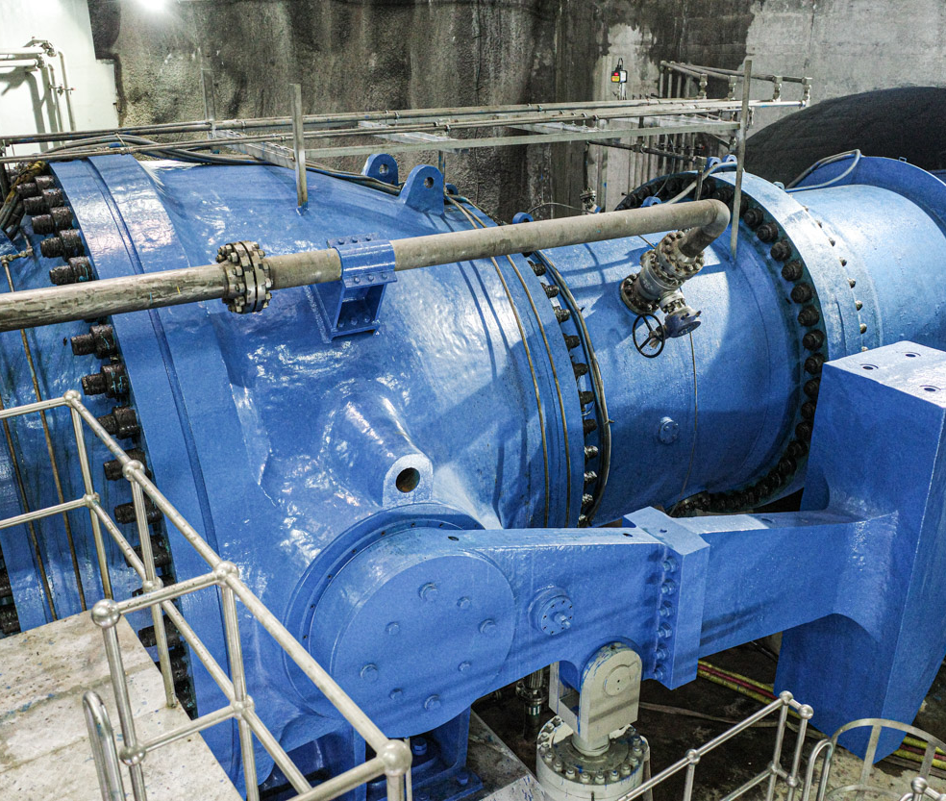
Inlet valves

Slide 10
Turbines

Slide 11
Turbine operation

Slide 12
Turbine cross-section
A turbine converts pressurized water into mechanical energy.
Major features of a HEP turbine include:
Inlet valve;
Scroll case;
Runner and shaft;
Draft tube.

Slide 13
Classification of turbines
Energy at inlet
Impulse
Direction of flow
Tangential
Head
RPM
Reaction
Radial
Axial
Cross
High
Medium
Low
High
Medium
Low
Turbines are not one-size-fits-all. They may be calibrated to suit particular requirements.
Relevant requirements include water pressure, flow direction and head.

Slide 14
Turbine selection
Pelton turbine
Impulse turbine
High head
Low discharge
Low speed
Francis turbine
Reaction turbine
Medium head
Medium discharge
Medium speed
Kaplan turbine
Reaction turbine
Low head
High discharge
High speed
Appropriate turbine selection usually governed by four criteria:
The energy at the inlet;
The height of the head; and
The water discharge;
The specific speed.

Slide 16
Performance and longevity
Performance and longevity of turbines are critical for HEP sustainability.
Two factors are ordinarily paramount: head and flow rate, and sedimentation.

Slide 17
Protective measures
Turbine protection
Inlet screens and trash rack
Desander
Surge tank
Pressure relief valve
Mechanical protection
Runner coating
Turbine protection can be achieved in a number of ways.
Optimum protection is site-specific and will usually involve a variety of techniques in conjunction.

Slide 18
Inlet screens and trash rack

Slide 19
Desander

Slide 20
Surge tanks

Slide 21
Pressure relief valve

Slide 22
Runner coating

Slide 23
Mechanical protection
Trip causes
Bearing oil level
Turbine overspeed
Inlet valve
Pressure relief valve
Vibration monitoring
Shaft seal
Bearing pad temperature

Slide 24
Generation and transmission

Slide 25
Generators
Generators convert the mechanical energy produced by a turbine into electrical energy which is then readied for transmission via the transformer hall and switchyard.
NJHEP’s generator hall includes four generators, each rated for 243MW, and expected to undertake 300 rpm.

Slide 26
Transformers
A transformer (also called a step-up substation) will increase the voltage of electricity produced by a HEP’s generators to allow for long-distance transmission.
Often included as part of the powerhouse in the transformer hall.

Slide 27
Switchyard
A switchyard is a facility external to a HEP in which voltage once transformed is directed through transmission lines into the power system.
Plays a major role in the security of the power system
NJHEP switchyard is rated for 575kV.

Slide 28
Transmission lines
Transmission lines carry electricity produced by the HEP into the power system.
HEPs generally use extra high voltage lines in the 265–275kV range but can be in higher ranges as well.

Slide 29
Substations
Beyond transformers, there are multiple other types of substation in a power system:
Step-down substation: decreases voltage for local distribution.
Distribution substation: supplies electricity direct to consumers.
Switching substation: reroutes power flows in cases of maintenance or repair.

